Slide 1
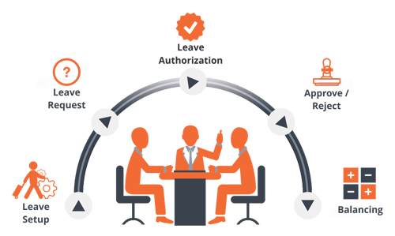
leave.lasu.edu.ng
Mon
Tue
Wed
Thu
Fri

Slide 2
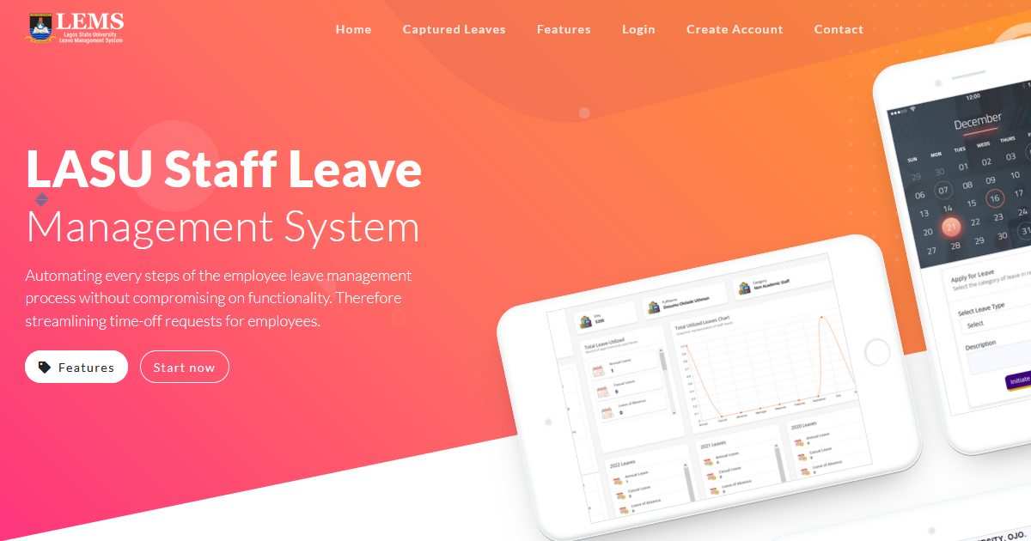
HOMEPAGE
Mon
Tue
Wed
Thu
Fri

Slide 3
CREATE ACCOUNT
Fill all required fields and click the “Create Account” button to proceed
Mon
Tue
Wed
Thu
Fri

Slide 4
LOGIN
Enter your login details after creating account successfully, then click the “Login” button.

Slide 5
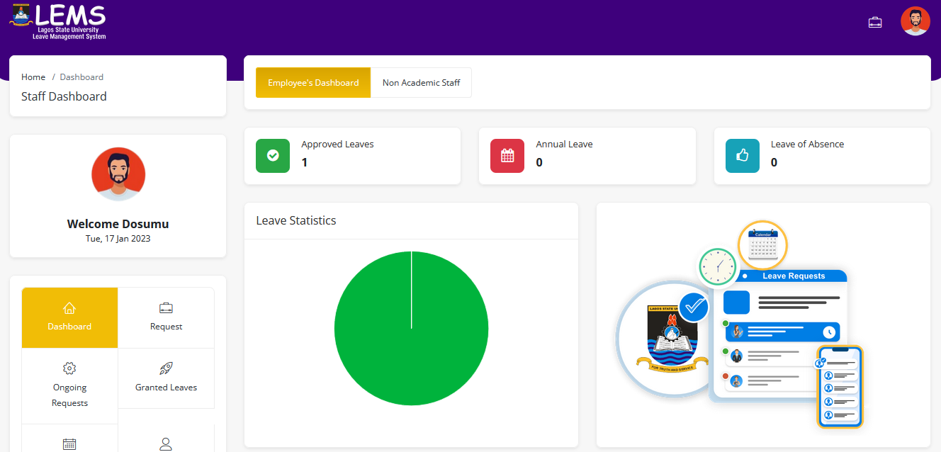
DASHBOARD
Click the “Request” link to initiate leave.

Slide 6
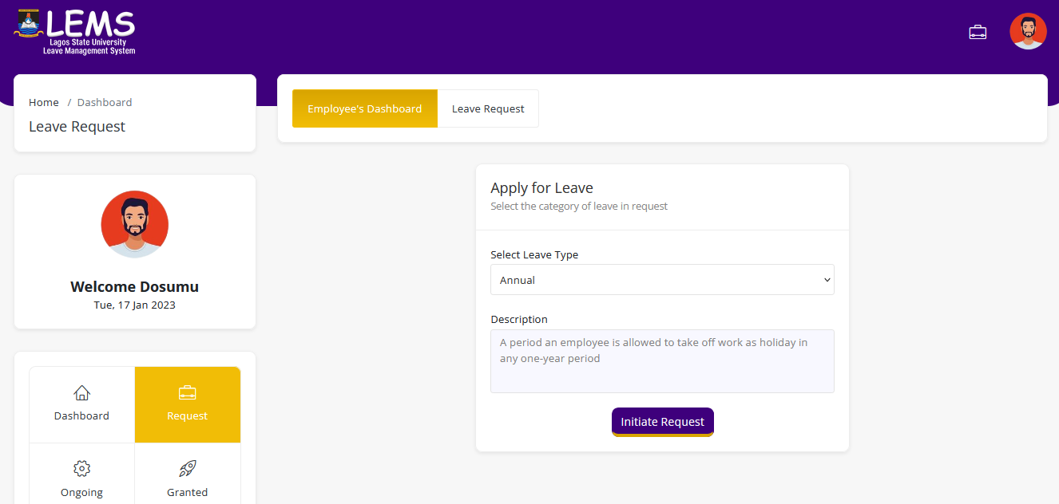
LEAVE APPLICATION
Select the type of leave to apply for
Click the “Initiate Request” button to proceed

Slide 7
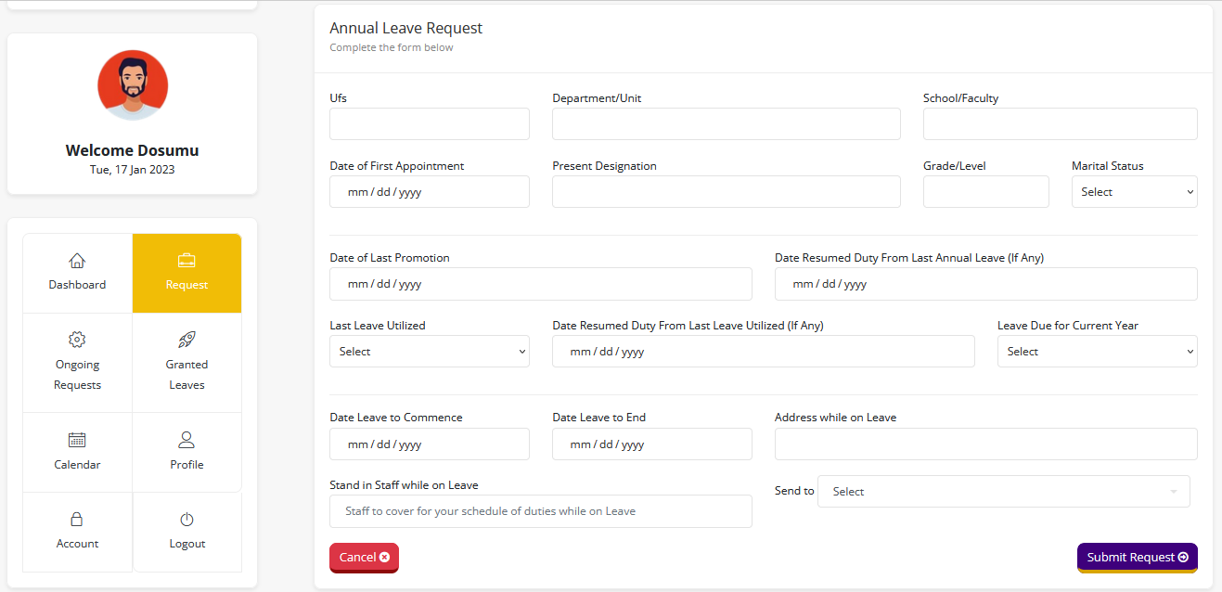
LEAVE APPLICATION
Fill all required fields in respect to the selected leave type.
Click the “Submit Request” button to submit request.

Slide 8
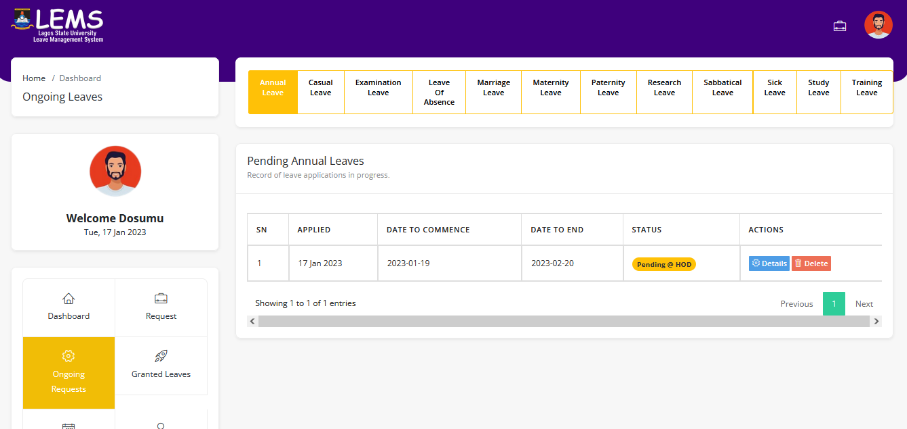
LEAVE PROGRESS
1. Click the “Ongoing Request” link to see
applied leave progress.
2. Click the “details” button to see the full leave details.

Slide 9
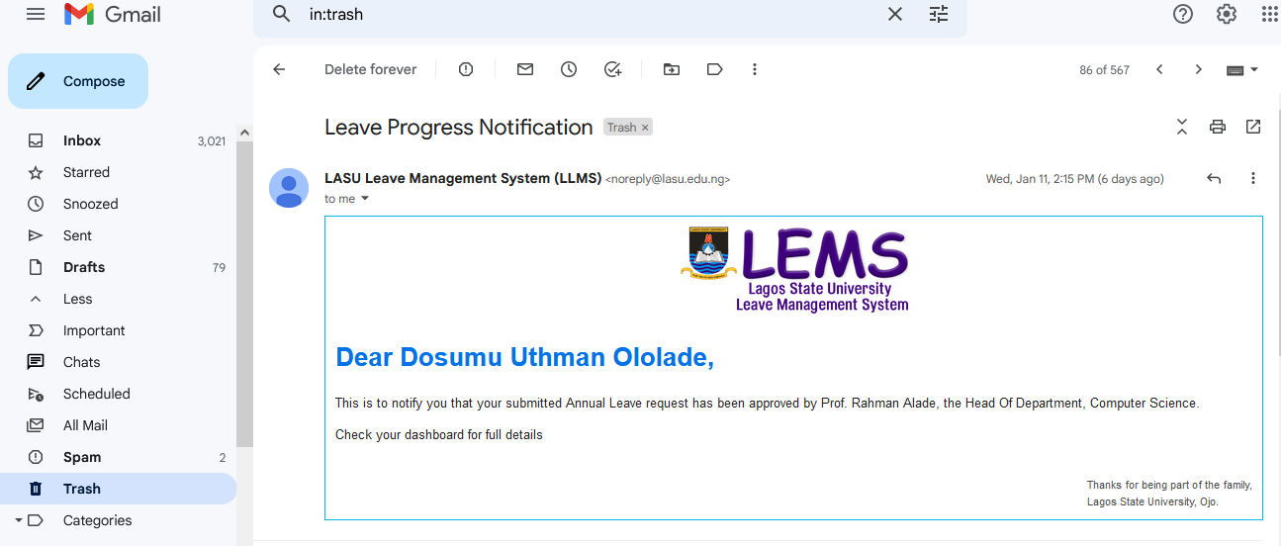
LEAVE PROGRESS NOTIFICATION
As the request progresses through the workflow and is approved or declined by the relevant approver(s), e-mail notifications will be sent to you.

Slide 10
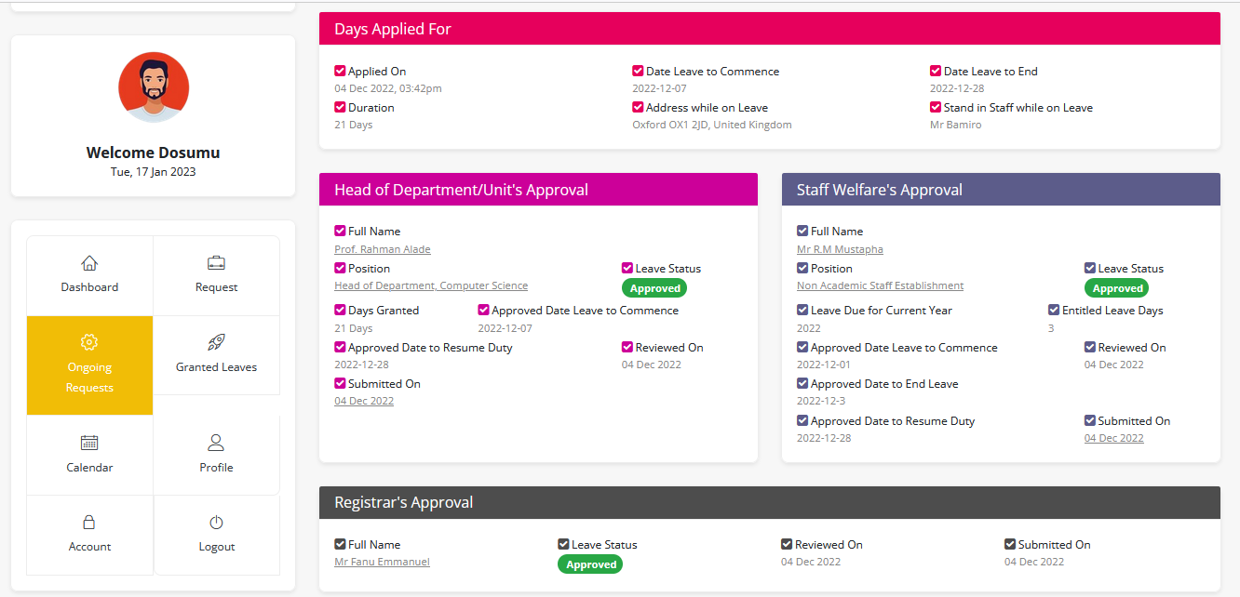
LEAVE DETAILS

Slide 11
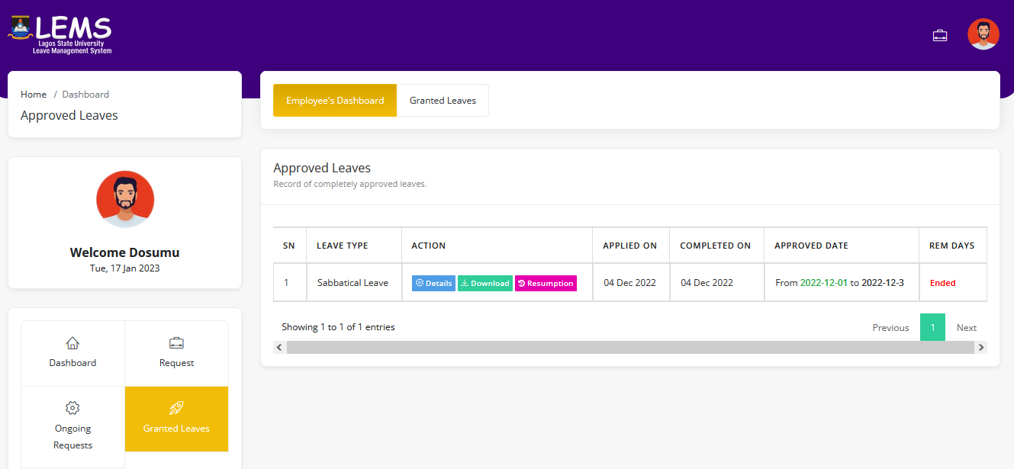
APPROVED LEAVES
2. Click the “Download” button to download or print fully approved leave form
3. Click the “Resumption” button to apply for resumption of duty as soon you resume from leave.
1. Click the “Granted Leaves” link to see approved leaves

Slide 12
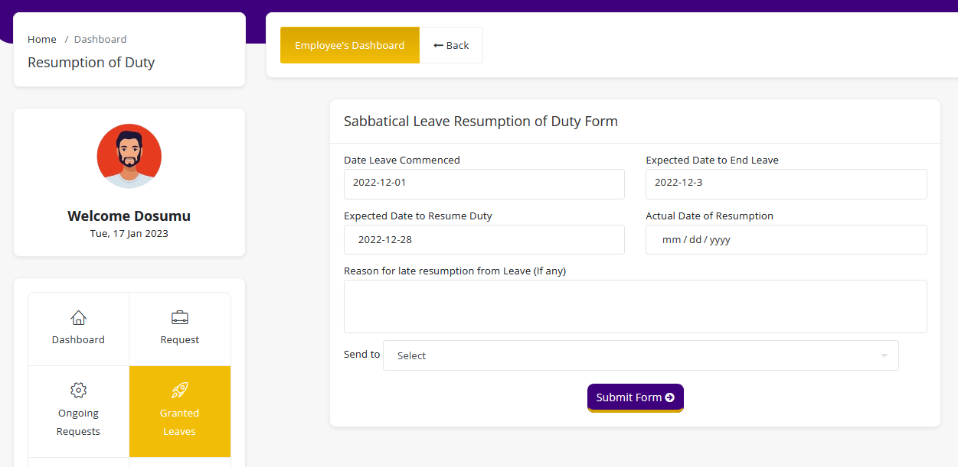
RESUMPTION OF DUTY
Fill all required fields and click the “Submit form” button.
You will receive a notification once the form has been treated across all required stages of approvals

Slide 13
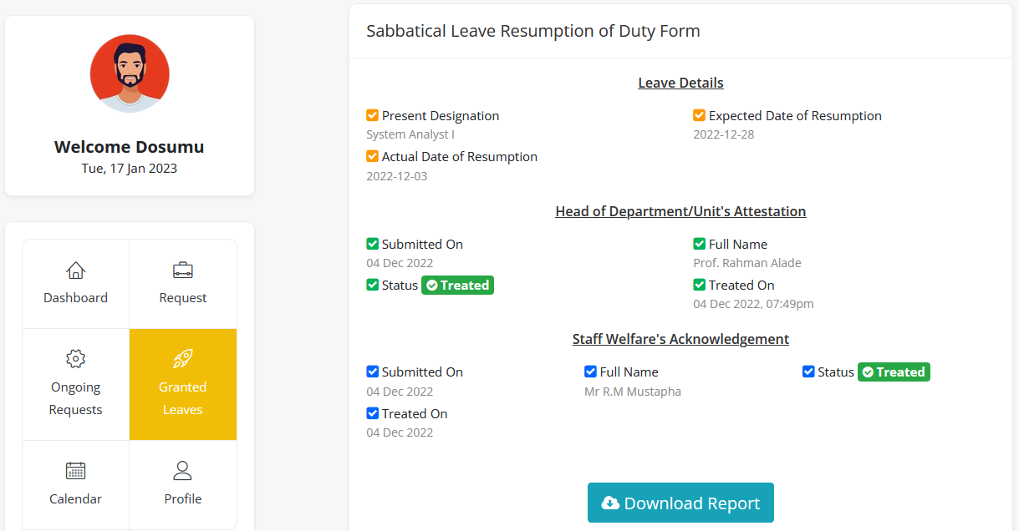
RESUMPTION OF DUTY
Once the application has been approved and acknowledged across all necessary stages, click the “Download Report” button to download or print report.

Slide 14
THANKS

